Slide 1
Weekly Report
Dian Hanifudin Subhi

Slide 2
Outline
Weekly report
Summary of this week’s work
Your work
Conclusion
Your opinion/thought
Action item

Slide 3
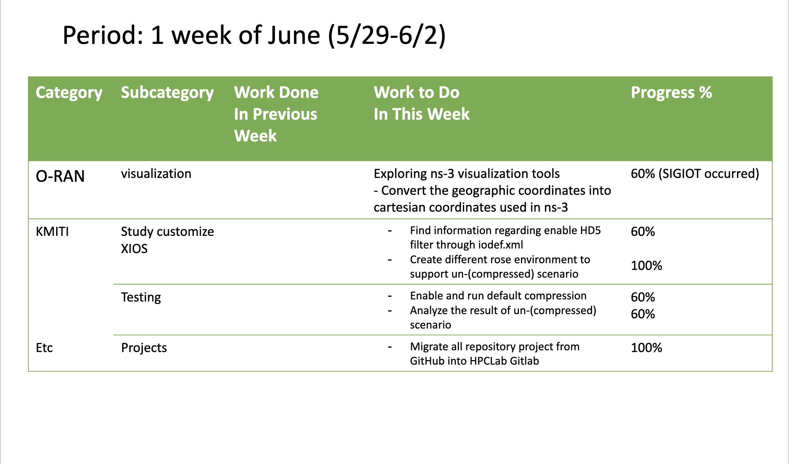
Weekly report

Slide 4
Summary of work this week
Migrate the repositories
Exploring ns-3 visualization tools
Evaluate compressed and uncompressed scenarios

Slide 5
Question to be Answered
How is the progress of the ns-3 visualization?
What is the I/O performance compressed and uncompressed scenario?

Slide 6
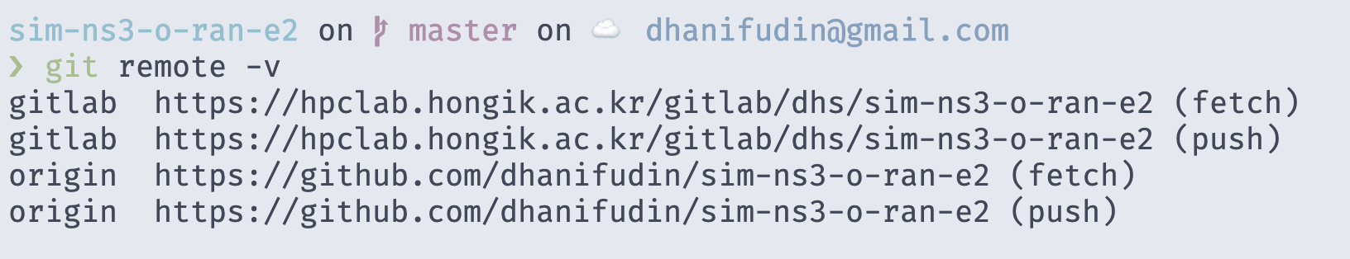
Migrate Repositories
migrate from GitHub into HPClab Gitlab
The Projects related to O-RAN hosting at GitHub
Modified the repositories is needed -> the fork repositories
The projects need to be hosted at HPCLab Gitlab
Git support multiple remote repositories as shown picture below

Slide 7
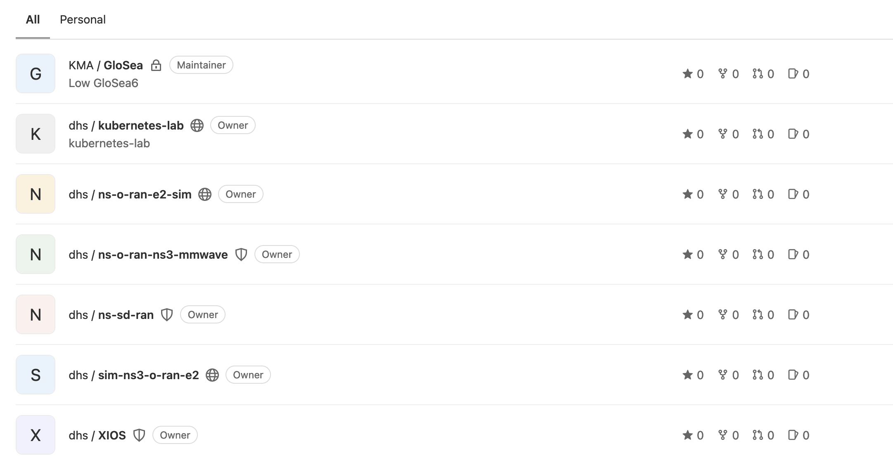
Migrate Repositories
migrate from GitHub into HPClab Gitlab

Slide 8
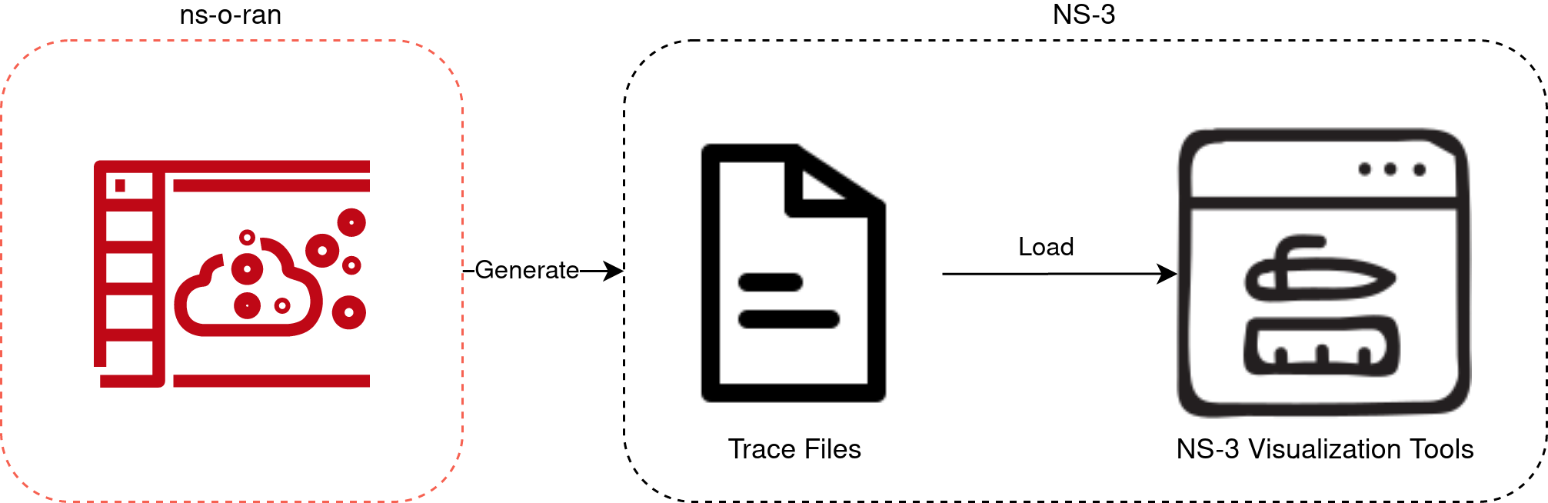
NS-3 visualization
block diagram

Slide 9
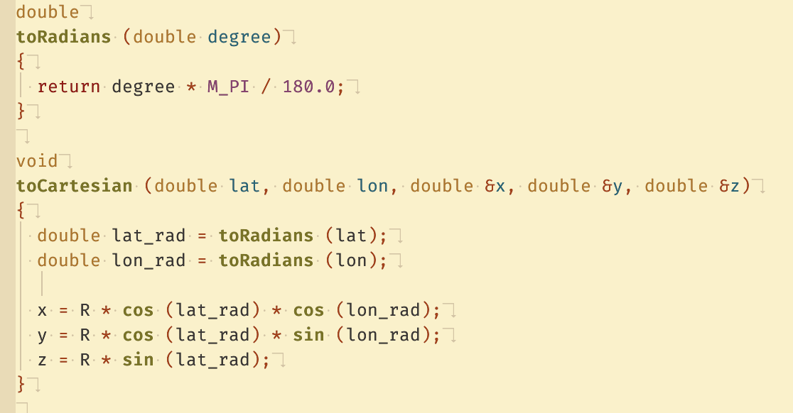
NS-3 visualization
Converting Coordinates
Add function to convert coordinates
SIGIOT occurred

Slide 10
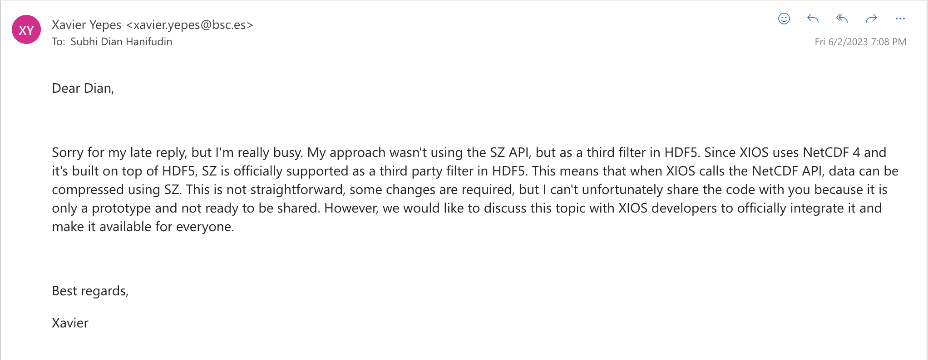
Study customize XIOS
Exploring the SZ lossy compressor use for the XIOS I/O server

Slide 11
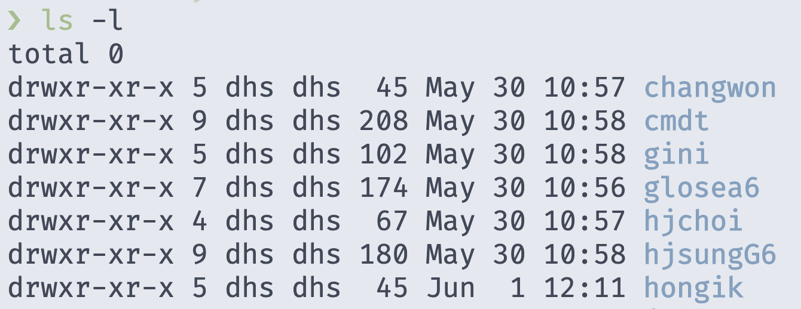
Customize the iodef.xml
Create hongik svn branch
Make svn branch using following command
svn copy svn://203.249.90.2/glosea_2023/um/main/branches/dev/changwon svn://203.249.90.2/glosea_2023/um/main/branches/dev/hongik -m 'modify iodef'

Slide 12
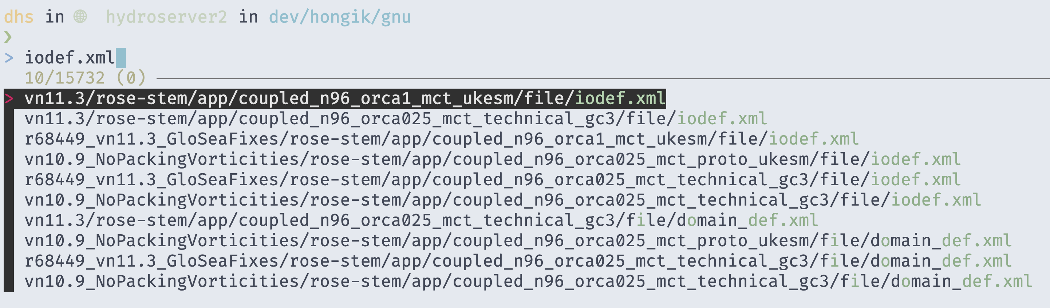
Customize the iodef.xml
Create hongik svn branch
The iodef.xml files candidates as shown picture below

Slide 13
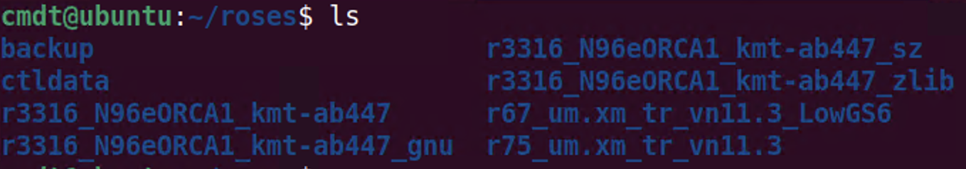
Customize the iodef.xml
Create Rose environment for different scenarios
Create Rose environment for different scenarios
Adjust the rose-app.conf from fcm_make_ocean and fcm_make_um using svn branch hongik.
Run the model using the compressed scenario

Slide 14
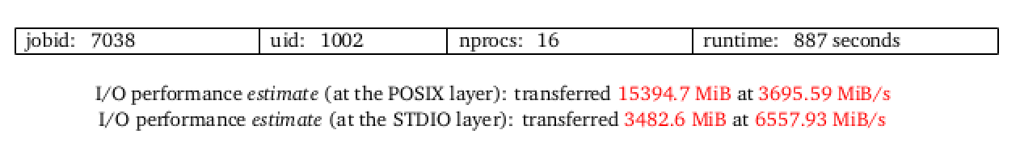
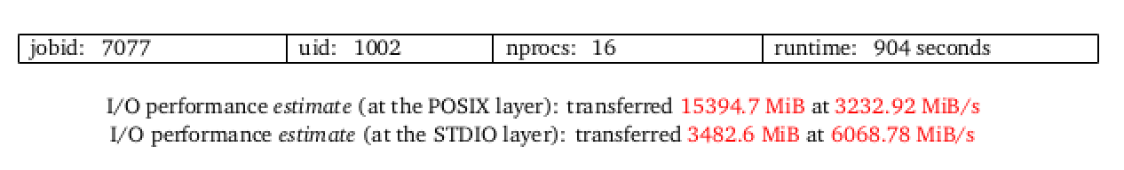
Customize the iodef.xml
Check darshan log
Run darshan-job-summary.pl hongik_h_atmos.exe to get summary of performance as shown pictures below
Uncompressed scenario
Compressed scenario

Slide 15
Conclusion
The SIGIOT occurred when running ns-3 simulation after the coordinates conversion
No difference in I/O performance compressed and uncompressed that indicates modified of iodef.xml is not successful.
The project migrated successfully into HPCLab Gitlab

Slide 16
Your opinion/thought
Enable logging of latitude and longitude values to ensure the values have valid for coordinates conversion.
The iodef.xml modification is not successful. The compression option maybe can be forced directly from the code.

Slide 17
Action items
Enable logging and convert yaml topology from RAN simulator into compatible ns-3 topology
Adjust the code to enable compression.
Test the SZ compression using H5Z-SZ filter.

